Slide 1
Digital Image Processing
Lecture 6: Image Enhancement in Frequency Domain-I

Slide 2
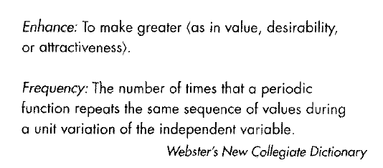
Introduction

Slide 3
Background (Fourier Series)
Any function that periodically repeats itself can be expressed as the sum of sines and cosines of different frequencies each multiplied by a different coefficient
This sum is known as Fourier Series
It does not matter how complicated the function is; as long as it is periodic and meet some mild conditions it can be represented by such as a sum
It was a revolutionary discovery

Slide 4
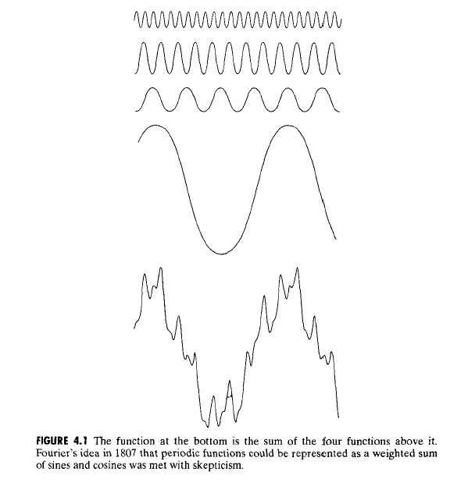

Slide 5
Background (Fourier Transform)
Even functions that are not periodic (but whose area under the curve is finite) can be expressed as the integrals of sines and cosines multiplied by a weighing function
This is known as Fourier Transform
A function expressed in either a Fourier Series or transform can be reconstructed completely via an inverse process with no loss of information
This is one of the important characteristics of these representations because they allow us to work in the Fourier Domain and then return to the original domain of the function

Slide 6
Fourier Transform
‘Fourier Transform’ transforms one function into another domain , which is called the frequency domain representation of the original function
The original function is often a function in the Time domain
In image Processing the original function is in the Spatial Domain
The term Fourier transform can refer to either the Frequency domain representation of a function or to the process/formula that "transforms" one function into the other.

Slide 7
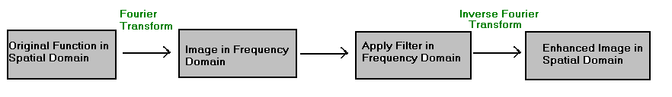
Our Interest in Fourier Transform
We will be dealing only with functions (images) of finite duration so we will be interested only in Fourier Transform

Slide 8
Applications of Fourier Transforms
1-D Fourier transforms are used in Signal Processing
2-D Fourier transforms are used in Image Processing
3-D Fourier transforms are used in Computer Vision
Applications of Fourier transforms in Image processing: –
  Image enhancement,
  Image restoration,
  Image encoding / decoding,
  Image description

Slide 9


One Dimensional Fourier Transform and its Inverse
The Fourier transform F (u) of a single variable, continuous function f (x) is
Given F(u) we can obtain f (x) by means of the Inverse Fourier Transform

Slide 10
One Dimensional Fourier Transform and its Inverse
The Fourier transform F (u) of a single variable, continuous function f (x) is
Given F(u) we can obtain f (x) by means of the Inverse Fourier Transform

Slide 11


Discrete Fourier Transforms (DFT)
1-D DFT for M samples is given as
The Inverse Fourier transform in 1-D is given as

Slide 12
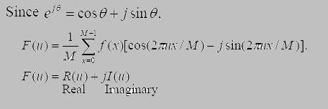
Discrete Fourier Transforms (DFT)
1-D DFT for M samples is given as
The inverse Fourier transform in 1-D is given as

Slide 13

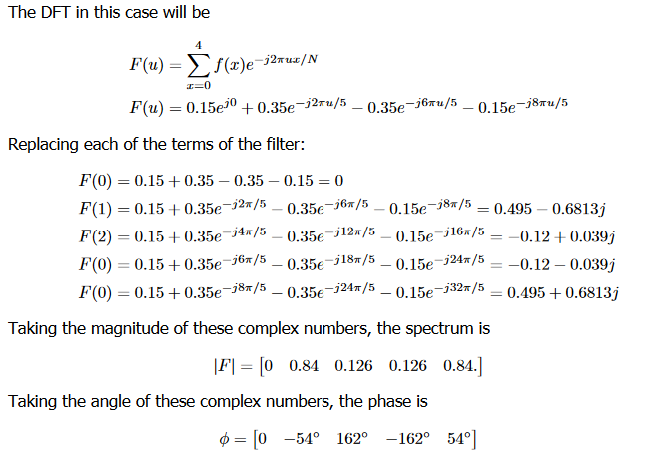

Slide 14
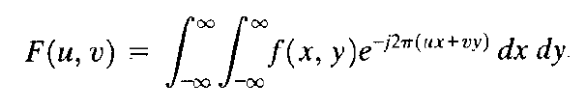

Two Dimensional Fourier Transform and its Inverse
The Fourier transform F (u,v) of a two variable, continuous function f (x,y) is
Given F(u,v) we can obtain f (x,y) by means of the Inverse Fourier Transform

Slide 15
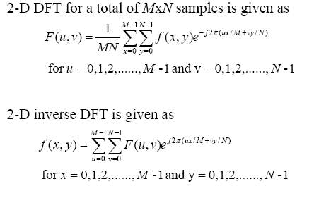
2-D DFT

Slide 16
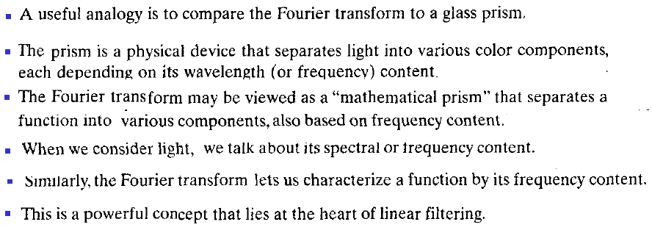
Fourier Transform

Slide 17
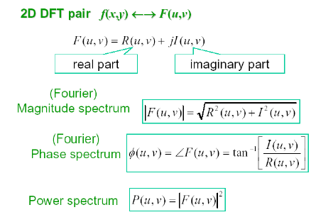
2-D DFT

